Slide 1
Sentiment Analysis in Twitter (French Language)
Contributed by:
Tabassum Tahera – 1413986
Md Asir Faisal - 1421837
Course: Natural Language Processing, IIUM
Instructor: Madam SURIANI BT. SULAIMAN

Slide 2
What is Sentiment Analysis?
It is classification of the polarity of a given text in the document, sentence or phrase
The goal is to determine whether the expressed opinion in the text is positive, negative or neutral.

Slide 3
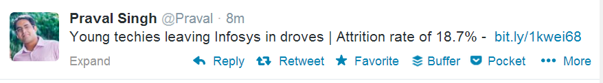
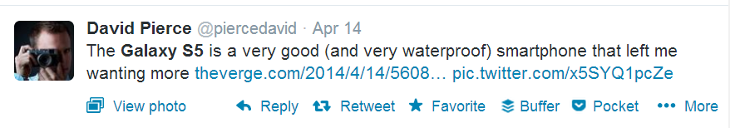
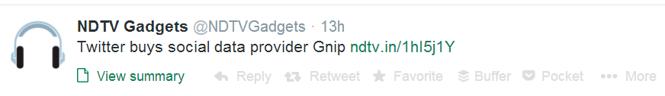
Negative
Positive
Neutral

Slide 4
Why is Sentiment Analysis Important?
Microblogging has become popular communication tool
Opinion of the mass is important
Political party may want to know whether people support their program or not.
Before investing into a company, one can leverage the sentiment of the people for the company to find out where it stands.
A company might want find out the reviews of its products

Slide 5
Using Twitter for Sentiment Analysis
Popular microblogging site
Short Text Messages of 140 characters
240+ million active users
500 million tweets are generated everyday
Twitter audience varies from common man to celebrities
Users often discuss current affairs and share personal views on various subjects
Tweets are small in length and hence unambiguous

Slide 6
Our Case Study
We have chosen a specific case study. We are collecting tweets related to French Parliament Debate and its candidates.
Our target users are the 7 candidates of that particular debate. They are : 'Sarkozy', 'Kosciusko', 'Cope', 'Juppe', 'Fillon', 'Le Maire', 'Poisson‘.
We are just focusing on the French Language. In order to do that for French Language we are importing 2 libraries which are: PatternTagger, PatternAnalyzer from TextBlob FR (For French)

Slide 7
Approach
Tweeter Authentication
Prepare Query Features
Get Sentiment Label of each Tweets
Retrieve Tweets and Save them
Output the result in csv files

Slide 8
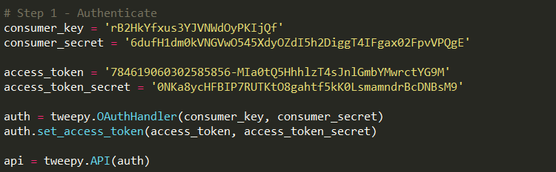
Twitter Authentication
Before getting any tweets, we need to set up our authentication module.
We need 4 keys with twitter to get access. They are : consumer key, consumer secret, access token, access secret

Slide 9
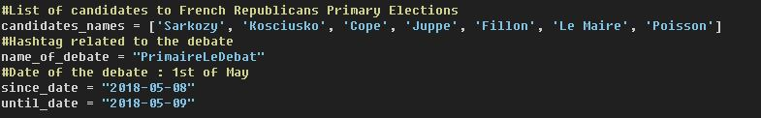
Prepare Query Features
7 Target Users. Candidates Names.
Hashtag related to the debate : PrimaireLeDebat
Since Date: 2018-05-08
Until Date: 2018-05-09

Slide 10
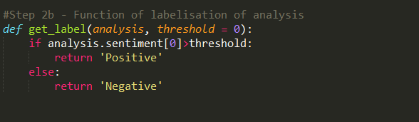
Getting the sentiment label
We are using the textblob python library to get the sentiment.I
Threshold Value > 0 = Positive, Threshold Value < 0 = Negative

Slide 11
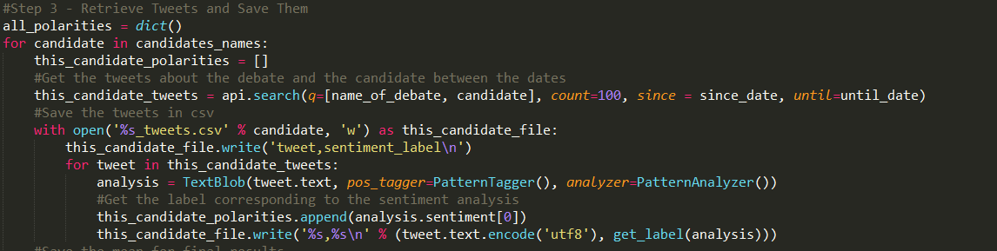
Getting Tweets and Output them
We use api search functions to process our query features and get the relevant tweets
Finally we output all the results in a csv file according to the candidates’ name to show the sentiment result.

Slide 12
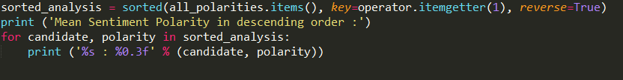
Mean Sentiment Polarity
We also try to get the mean sentiment polarity for each candidate.
Mean Sentiment Polarity in descending order :
Poisson : 0.180
Fillon : 0.113
Juppe : 0.098
Sarkozy : 0.057
Cope : 0.036
Le Maire : 0.007
Kosciusko : 0.007

Slide 13
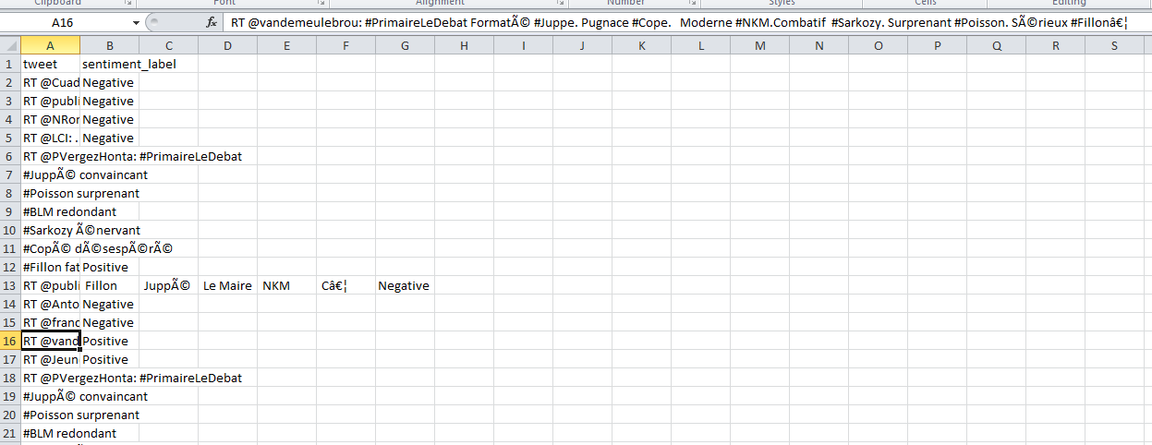
Outputs
Figure : Cope Tweets

Slide 14
Conclusion
We successfully implemented twitter sentiment analysis in French language in this project. This work can be extended to other languages as well.
Through our analysis of the relevant topic, we can get valuable insights and opinions of that particular topic.

